Slide 1

STARN
AUTOMATIC NUMBER PLATE RECOGNITION SYSTEM
Automatic Number Plate Recognition (ANPR) systems are designed to automatically read vehicle license plates using image processing and machine learning techniques.
GROUP PRESENTATION

Slide 2


Avatar Card Info
Name: Shivam Kumar
Year: Final
Project Name: CarCheck
Univ. Roll no- 220029002566
Role :Graphic Designer and Prototyping Expert ,Web developer
GROUP PRESENTATION

Slide 3
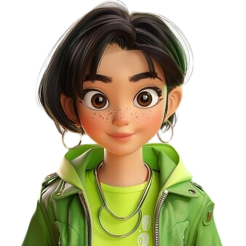

Avatar Card Info
Name: Tanu Sri
Year: Final
Project Name: CarCheck
Univ. Roll no- 220029002556
Role : Content Writer and Project Reporter
GROUP PRESENTATION

Slide 4

Avatar Card Info
Name: Abdul Razaq
Year: Final
Project Name: CarCheck
Univ. Roll no- 220029002584
Role : Backend Developer and Cloud Computing
GROUP PRESENTATION

Slide 5

Avatar Card Info
Name: Roushan Kumar
Year: Final
Project Name: CarCheck
Univ. Roll no- 220029002572
Role : Senior Python Developer I
GROUP PRESENTATION

Slide 6

Avatar Card Info
Name: Nikhil Kumar Singh
Year: Final
Project Name:CarCheck
Univ. Roll no- 220029002569
Role :Python Backend Developer
GROUP PRESENTATION

Slide 7
KEY COMPONENTS
01.
Image Acquizition
Capturing images of vehicles and their license plates using cameras
02.
Pre Processing
Enhancing the captured images to improve readability
03.
License Plate Detection
Identifying the location of the license plate in the image
04.
Character Segmentation
Identifying the location of the license plate in the image

Slide 8
KEY COMPONENTS
05.
Character Recognition
Capturing images of vehicles and their license plates using cameras
06.
Post Processing
Enhancing the captured images to improve readability
Datasets of Machine Learning included in this project : EasyOCR , TenserFlow , Pytessereact and YoloV8

Slide 9

YOUR LOGO
01
Objectives of the Automatic Number Plate
Recognition System Project
Prepared by:
STARN
PRESENTATION

Slide 10
Objectives of the Automatic Number
Plate Recognition System Project:
01.
Real-time License Plate Detection:
Develop a robust system capable of detecting license plates in real-time using
YOLOv8 for high accuracy and speed
02.
Efficient Image Pre-processing
Implement effective image enhancement techniques to improve the clarity and
readability of license plates under various conditions
03.
Accurate Character Recognition
Utilize EasyOCR to accurately recognize and convert license plate characters into text,
ensuring support for multiple languages.
04.
Seamless Integration
Ensure smooth integration of license plate detection and OCR components using
TensorFlow for end-to-end processing.

Slide 11
Objectives of the Automatic Number
Plate Recognition System Project:
05.
Error Handling and Correction:
Develop a robust system capable of detecting license plates in real-time using
YOLOv8 for high accuracy and speed
06.
Scalability and Adaptability
Implement effective image enhancement techniques to improve the clarity and
readability of license plates under various conditions
07.
User-friendly Interface
Utilize EasyOCR to accurately recognize and convert license plate characters into text,
ensuring support for multiple languages.
08.
Performance Optimization
Ensure smooth integration of license plate detection and OCR components using
TensorFlow for end-to-end processing.

Slide 12
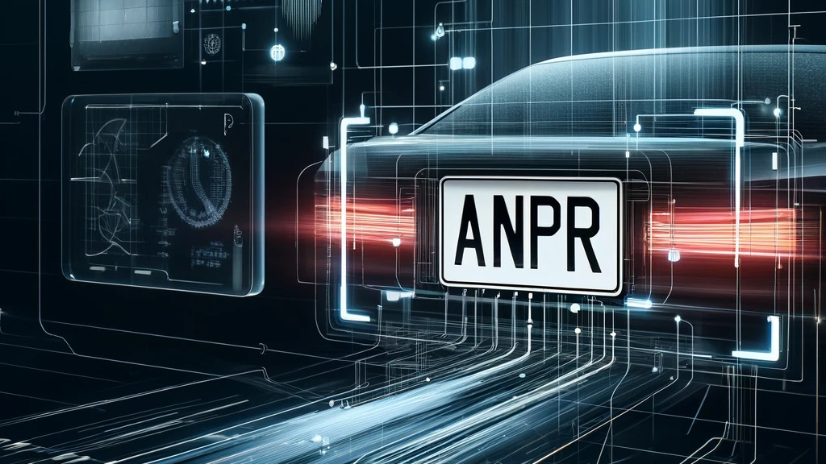
Objectives of the Automatic Number
Plate Recognition System Project:
09.
Data Privacy and Security
Ensure that the system adheres to data privacy and security standards, protecting
sensitive information.

Slide 13
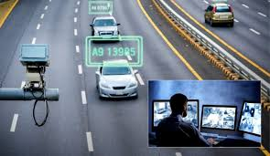
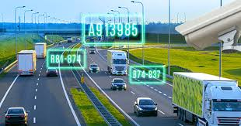

YOUR LOGO
Aim of the Automatic Number Plate Recognition System Project:
Enhance Traffic
Management
Reduce Manual
Intervention
Automate Toll
Collection
Support Law
Enforcement
Presentations are communication tools that can be used as demonstrations, lectures, speeches, reports, and more.
Strengthen Security Measure
Improve Data Accuracy
PRESENTATION

Slide 14
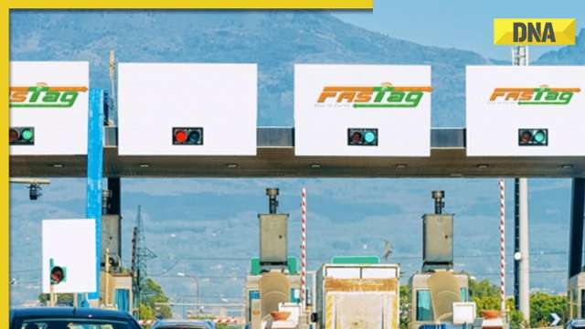
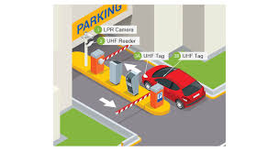
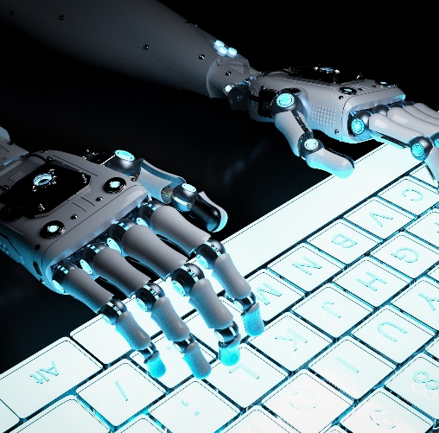
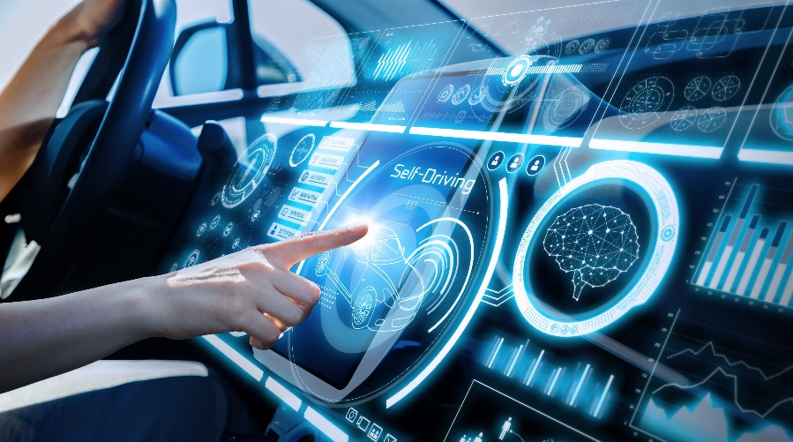
Areas of Implementation of the Automatic Number
Plate Recognition System
Traffic Management:
Parking Management
Security and Surveillance
Law Enforcement

Slide 15
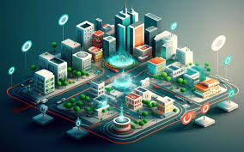
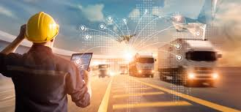
Areas of Implementation of the Automatic Number
Plate Recognition System
Smart Cities
Fleet Management
Border Contol

Slide 16

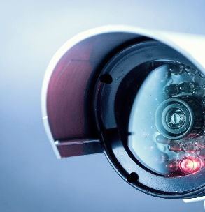
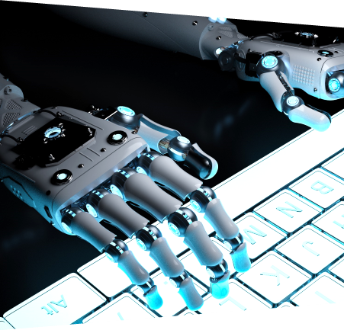
Requirements for the Automatic Number
Plate Recognition System
Hardware
Modules and Libraries
HIGH RESOLUTION CAMERAAS
GPU
Annotated datasets of vehicle
Pre-trained models
Software & Tools
PYTHON,OPENCV
TENSOR FLOW
YOLOv8,Easy OCR
ENVIRONMENT
Jupyter Notebook
Anaconda
Modules and Libraries
OTHER REQUIREMENTS
NumPY
Paandas
Matplotlib
Flask/ Django
Reliable Internet Connections
Storage Solutions

Slide 17
02
Example of Implementation through a Working Model

Slide 18
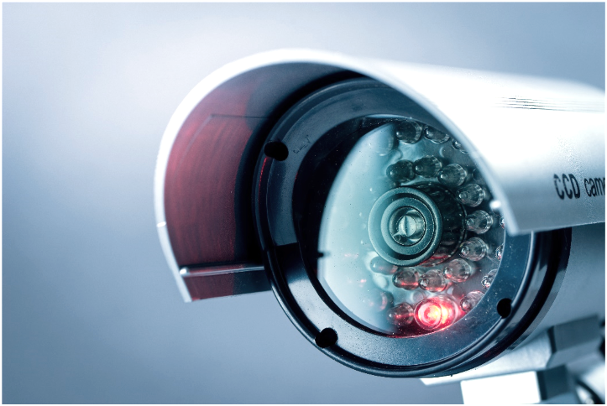
YOUR LOGO
Working of the Model
Setup Environment
Segment Characters
Capture Image
Recognize Characters
Post-process Results
PRODUCT
Pre-process Image
Display Results
WORKING PROCESS
Detect License Plate
Optimize and Test

Slide 19
YOUR LOGO
Flow of Control of the Automatic Number
Plate Recognition System Project
Image Acquisition
Character Recognition
Image Pre-processing
Post-processing
Post-process Results
PRODUCT
License Plate Detection
Output Result
WORKING PROCESS
Character Segmentation
Feedback Loop

Slide 20

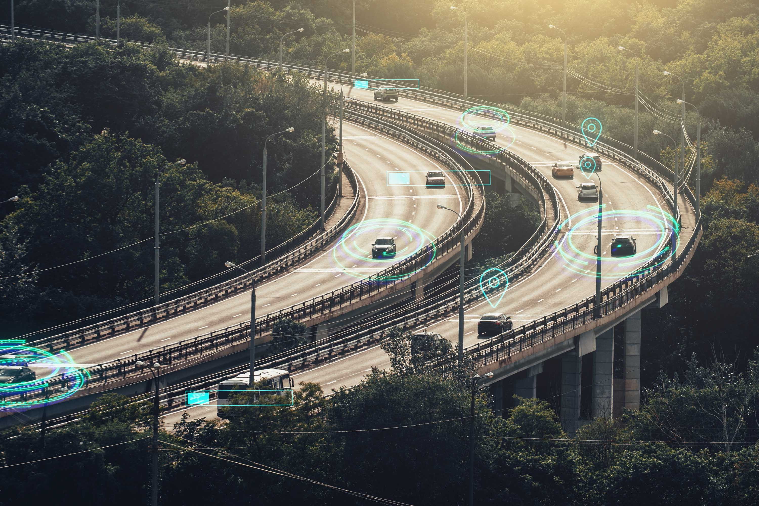
Future Impact , Implementation
Goals and More of ANPR Projecct
Technological Advancements
Integgration with smart cities
Expansion In Applications
Future
Technologies
AI
INTEGRATION
PRESENTATION

Slide 21
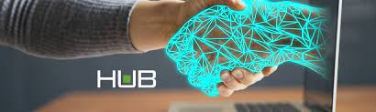
Implementation Goals
Scalibility
Accuracy and Reliability
User-Friendly Interfaces
Technological Advancements
Societal Impact
Long-Term Goals
AI INTEGRATION
IoT INTEGRATION
DATA SECURITY
Efficiency Gains
Safety Enhancement
Presentations are communication tools that can be used as demonstrations, lectures, speeches,
Global Adoption Continuous Improvement

Slide 22


FROM ALL THE TEAM STARN
SHIVAM TANNU ABDUL ROUSHAN NIKHIL
THANKYOU
TEAM MEMBERS
TEAM MEMBER
NIKHIL KUMAR SINGH
ROUSHAN KUMAR
TANU SRI
THANKS TO ALL FOR THE COORDINATION
ABDUL RAZAQ
SHIVAM GUPTA

